Slide 1

STUDENT DATA ANALYSIS
Department Of Computer Science And Engineering
Project Seminar On
Under the esteemed Guidance of
K . Navaneetha
Designation : Asst . Professor
Department : CSE
Batch No : 4
Name: K. Mounika -17P61A0593
G.Prabhavathi-17P61A0563
K.Rahul-17P61A0594
K .Sandhya Rani-17P61A05A4

Slide 2
Abstract :
Student data analysis is a study of methodology and an application of statistical techniques related to student’s data from academic database. Analytics is a process of discovering, analyzing and interpreting meaningful patterns from large amount of data. Almost every university have their own management system to manage the student’s records. The proposed system offers a analysis to student’s data in various forms .This project deals with understanding of student’s data by applying descriptive statistics ,visualization and categorization of student’s based on student’s grade , percentage ,rural ,urban ,local and non-local.

Slide 3
INTRODUCTION :
Student data analysis is a study of methodology and an application of statistical techniques related to student’s data from academic data base.
Analytics is a process of discovering, analyzing and interpreting meaningful patterns from large amount of data.
Almost every university have their own management system to manage the student’s records.
The proposed system offers a analysis to student’s data in various forms.
This project deals with understanding of student’s data by applying descriptive statistics, visualization and categorization of student’s based on student’s grade , percentage , rural, urban, local, and non-local.

Slide 4
To create a Student Data Analysis using R Language involving concepts of Searching and Sorting
and its analysis.
The software will contain all the necessary information regarding Student’s record. ■ Student data analysis is usually used in schools/colleges for storing records of student’s. All students’ information can be stored and different operations can
be performed on it through database. ■ Statistics for relatively advanced users: R has thousands of packages, designed, maintained,
and widely used by statisticians. ■ Flexible code: R has a rather liberal syntax, and variables don’t need to be declared as they would in (for example) C++,
which makes it very easy to code in. This also has disadvantages in terms of how safe the code is. ■ Vectorization : R is designed to make it very easy to write functions which are applied point wise to every element
of a vector. This is extremely useful in statistics. ■ In this project the student data is collected through Google Forms .The data base created through Excel sheets and
converted into csv (comma separated value) which is used in R Environment . ■ The data is imported into R environment and operations are performed on imported data.

Slide 5
PROBLEM STATEMENT :
To create a Student Data Analysis using R Language involving concepts of Searching and Sorting and its analysis.
The software will contain all the necessary information regarding Student’s record.
Student data analysis is usually used in schools/colleges for storing
records of student’s.
All student’s information can be stored and different operations can be performed on it through database.
Descriptive statistics can be used to analyze the data.
Descriptive statistics is a summary statistics that quantitatively describes or summarizes features of a collection of information.

Slide 6
Objective :
The objective of the project is to create Student Data Analysis to store the Name, Roll Number, Gender, Group, Father Name,
Mother Name, etc. using Excel sheets and importing the data into the R Environment.
In this software one can easily add Students records, sort students record, search students record, compute and view all students records .
This application stand out among all other software in a way that it is user friendly and can be modified easily as per the requirements. It allows user to add new/view/sort/search records.
Understand the basic concepts 'R' programming
Learn handling of Data and Data sets
General Programming Components and its implementation in R
Hands on Sessions for Descriptive Statistics
Visualization Methods (Graphical Analysis)
Shows the path to enter into Data Science and Data Analytics world

Slide 7
SOFTWARE AND HARDWARE REQUIREMENTS
SOFTWARE AND HARDWARE REQUIREMENTS Languages Used:
1.C 2.R and R studio 3.Excel Sheet 4.Google forms HARDWARE REQUIREMENTS 1.RAM:4.00GB 2.HDD:Harddisk 8GB 3.Processor : Intel® core™ 2duo CPU E8400@ 3.00GHz 3.00GHz 4. System type : 64bit Operating system

Slide 8
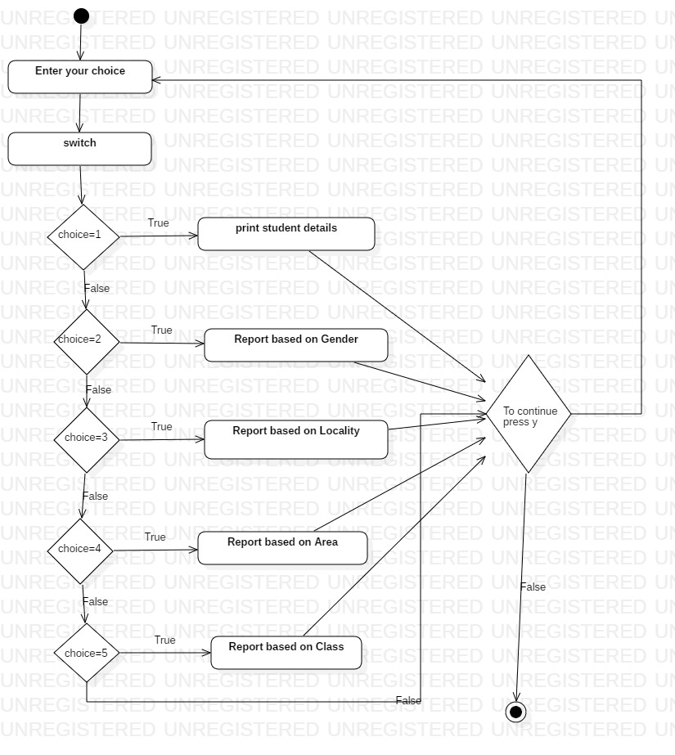
FLOW CHART REPRESENTATION

Slide 9
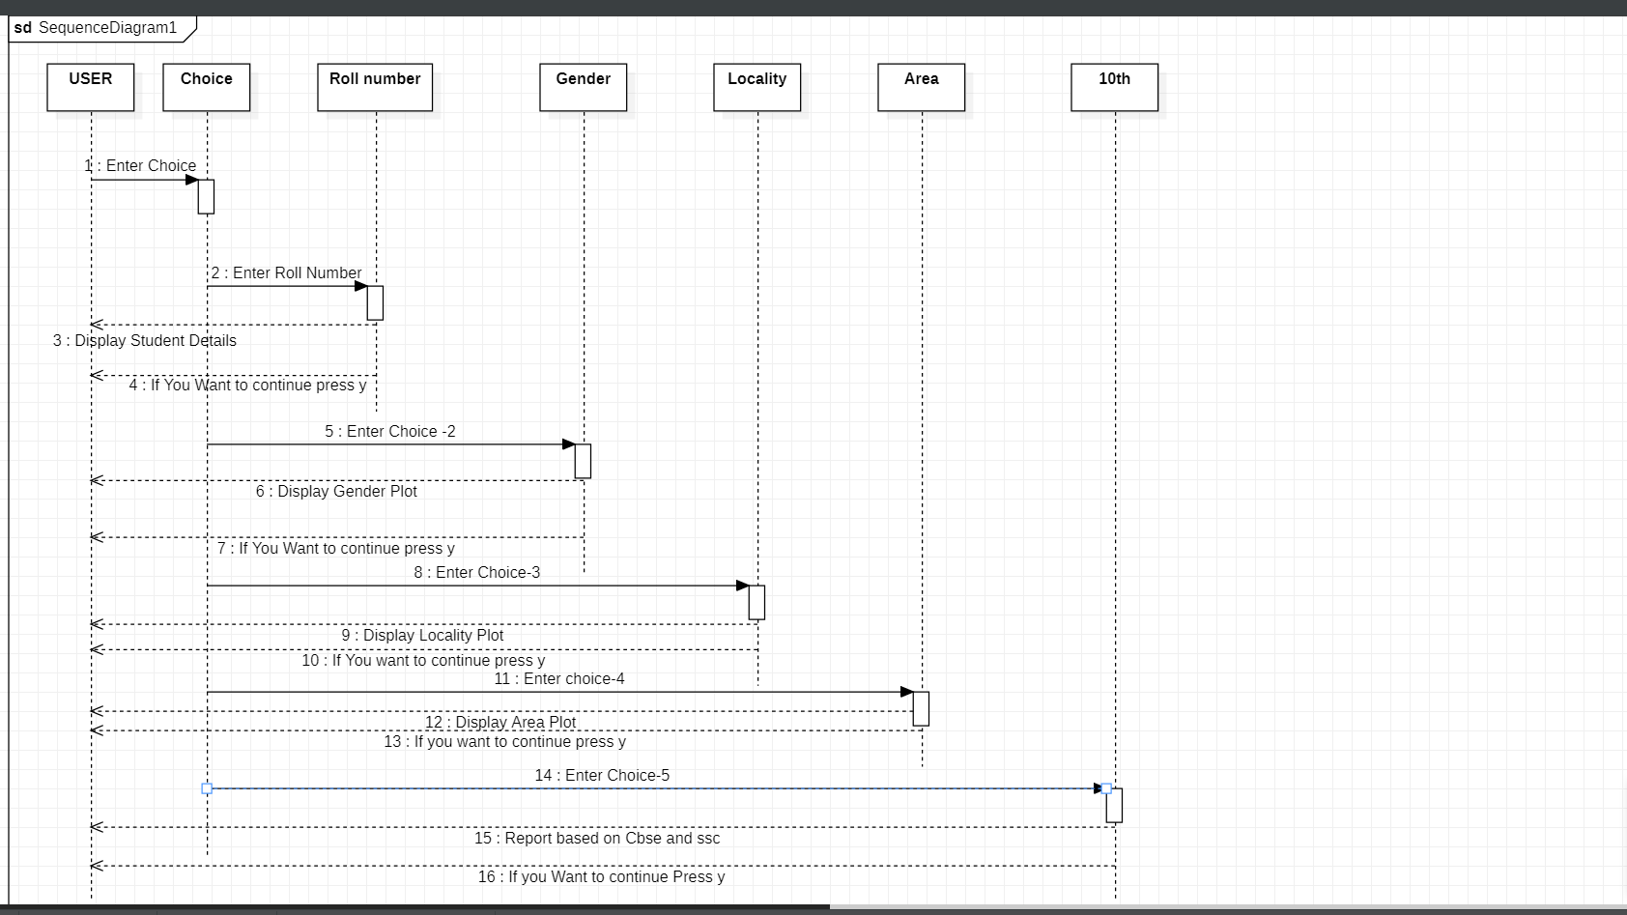
Sequence Diagram

Slide 10
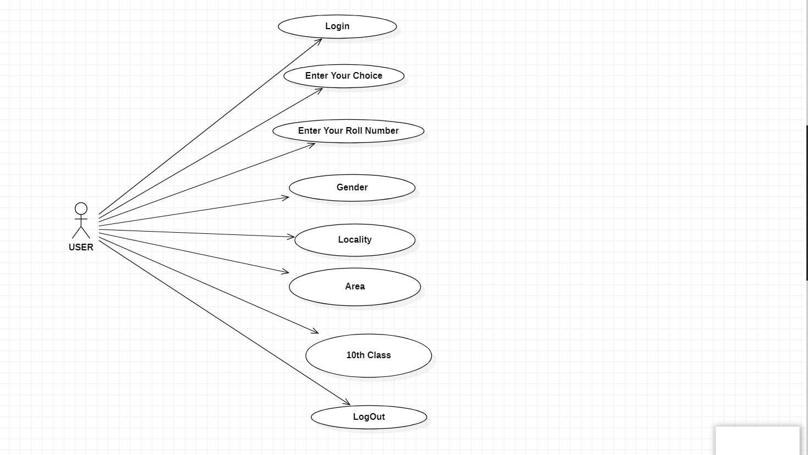
Use Case Diagram

Slide 11
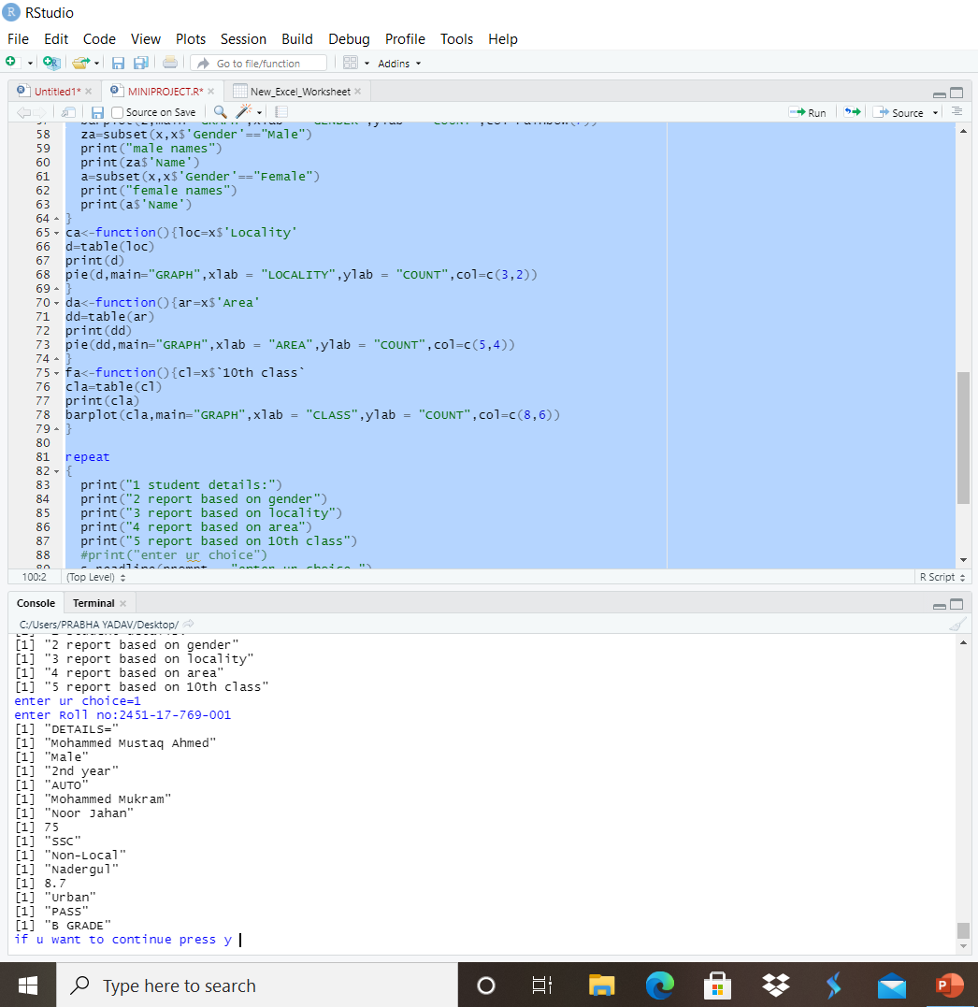
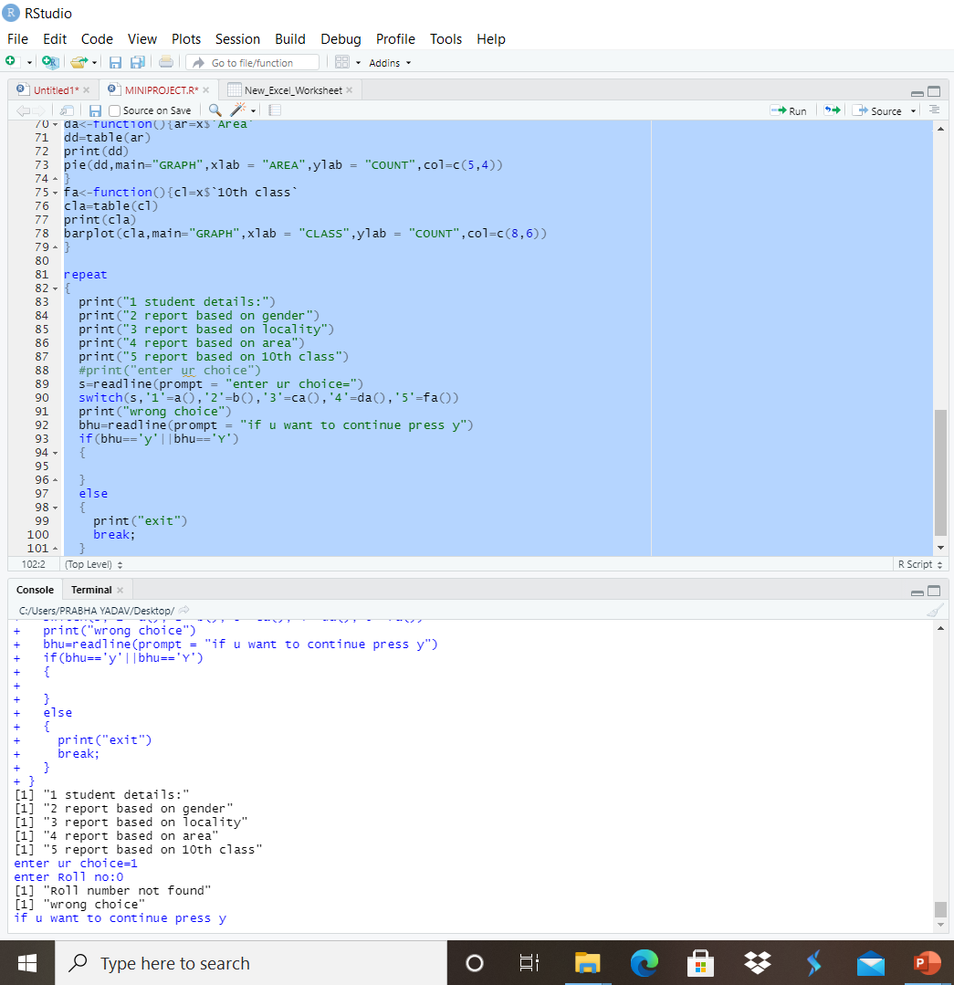
TESTING
Case 1:Details of Student by Entering roll no:

Slide 12
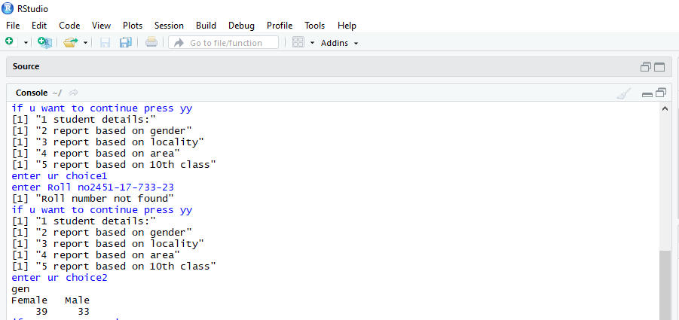
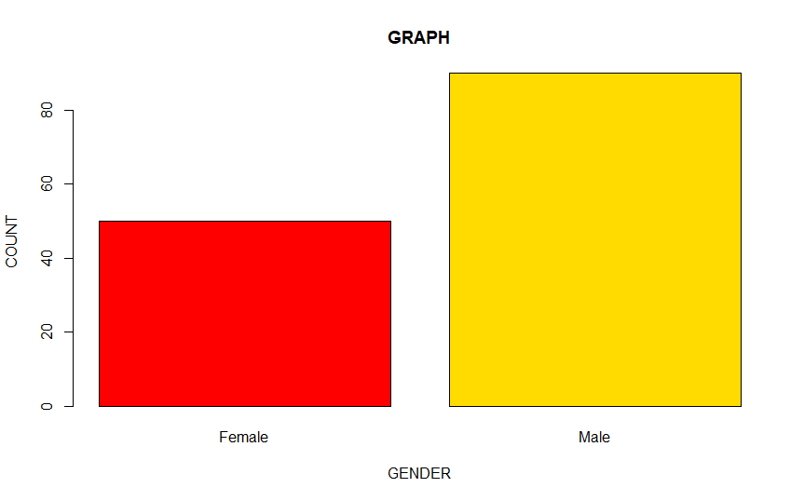
Report On Gender

Slide 13
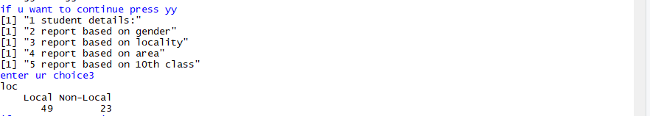
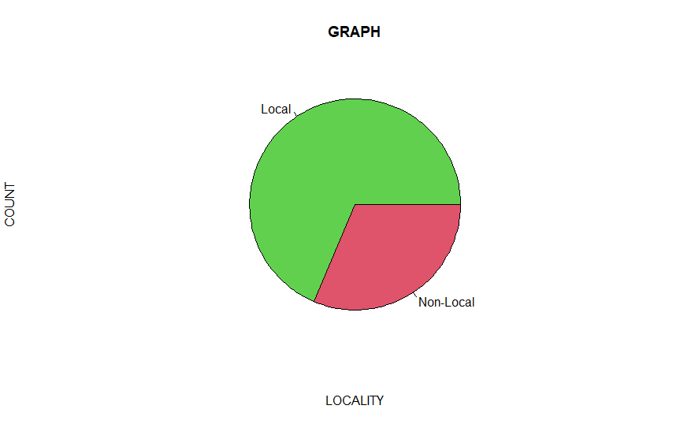
Report On Locality

Slide 14
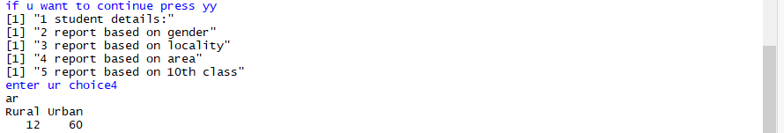
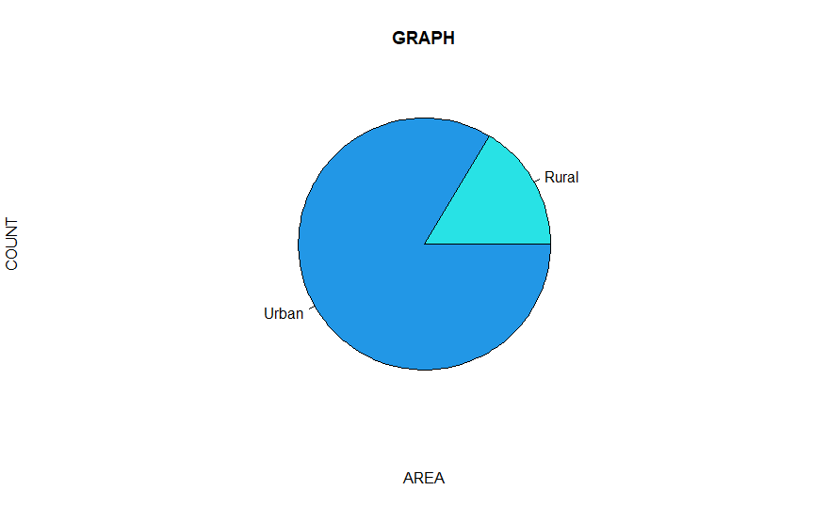
Report On Area

Slide 15
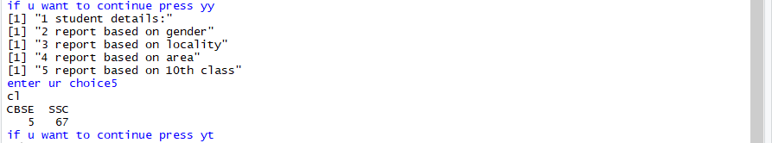
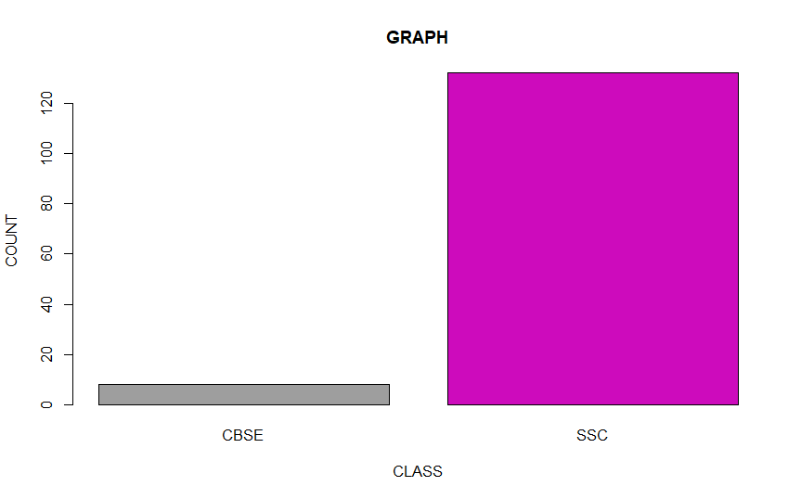
Report On Class

Slide 16
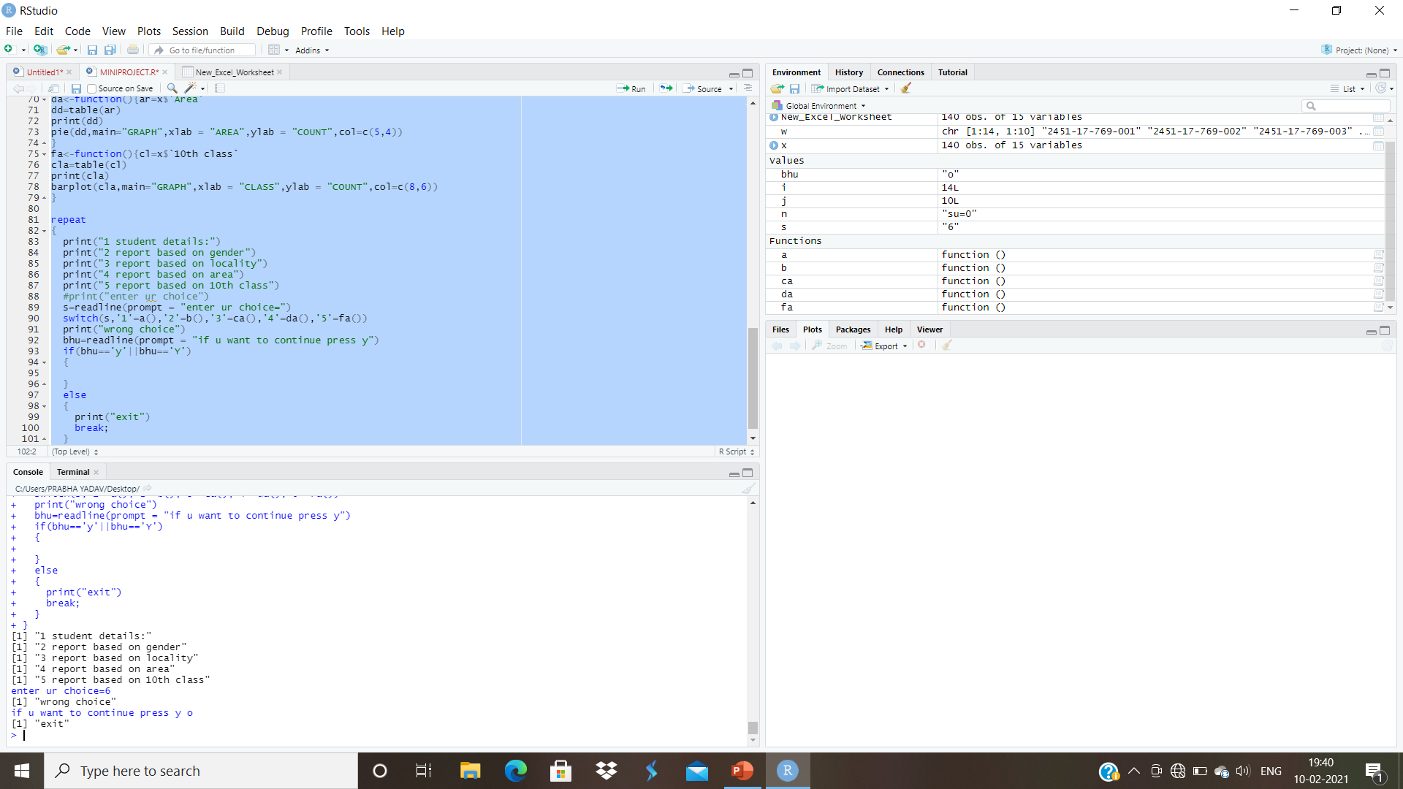
CASE 3 Entering wrong choice

Slide 17
Application
The student can analyze their data based on roll number.
Student’s data is visualized and categorized based on student’s grade,
percentage, rural, urban, local
and non-local.
Generating reports on the student data based on different categories.
Visualizing reports with graphs like bar graph, plot graph, pie graph, histogram etc.

Slide 18
FUTURE SCOPE OF THE PROJECT
Other Possible Modules
Academic
Attendance Management
Lab Management
Library
Hostel

Slide 19
REFERENCES
Beginner's Guide for Data Analysis using R Programming Paperback – 2018 by Jeeva Jose (Author)
Beginning R: The Statistical Programming Language Paperback – 2013 by Mark Gardener (Author)
Learn R in a Day Kindle Edition by Steven Murray (Author)
https://www.tutorialspoint.com/r/index.htm
https://www.rstudio.com

Slide 20
Conclusion
The project clearly depicts that the Student Data Analysis is very efficient. It shows how the concept of database like excel is used.
The project is an effort to develop a simple student data analysis which may be useful for the students to analyze their data. The data analysis can be done based on reports.
The student can retrieve their data based on roll number. The student can also analyze the data based on different categories like gender, locality, area, class.
Although this software can be further modified to be used as multitasking and bigger software, but it effectively under the condition of limited resources and time.
The project can be modified to add web page link to R environment and we can also develop a web page using R html .

Slide 21
Thank you

